Slide 1
Videos to queue up
Supreme Commander 2
https://www.youtube.com/watch?v=iHuFCnYnP9A
Conway’s Game of Life
https://www.youtube.com/watch?v=C2vgICfQawE
Lion King Wildebeest Stampede
https://www.youtube.com/watch?v=FbLA0LS67XE
Stanley and Stella in Breaking the Ice
https://www.youtube.com/watch?v=aYEp26g14Wk
Starling Swarm
https://www.youtube.com/watch?v=DmO4Ellgmd0
https://www.red3d.com/cwr/steer/ (Install “CheerpJ” Applet Runner for Chrome to view)

Slide 2
Artificial Intelligence for Games Week 3 – Movement 1 Steve Rabin
For help on projects, email everyone (select and copy this string from the start of any class PowerPoint):
steve.rabin@gmail.com, p.jiankai@digipen.edu, b.hsu@digipen.edu, zak.s@digipen.edu, keaton.sullivan@digipen.edu, john.tseng@digipen.edu, a.roulst@digipen.edu
TAs: Jian Kai Phua, Brandon Hsu, Zak Stephenson, Keaton Sullivan, John Tseng, Andrew Roulst

Slide 3
Questions
Name one advantage of a visual programming language (like a behavior tree editor)?
Name one disadvantage of a visual programming language?
If you want to test a condition, like is enemy within 5m, then where does that go inside a behavior tree?
Name 3 control flow nodes (not leaf or decorators).
Name 3 things that a decorator could do.

Slide 4
Project 1: Step-by-Step
Code to edit is in Student/Project_1
Create node classes (look at examples)
Add new nodes to: Nodes.def
Use BehaviorTreeEditor.exe to build trees
Add new trees to Trees.def and NodeHeaders.h
Register agents and assign tree to each agent in Setup.cpp

Slide 5
Project 1: Directions (copied from Moodle)
Download the base code from: https://github.com/CS380-GameAI/Rabin-Engine
Ensure you meet the coding requirements from the slides (4+ agents, 10+ custom nodes, 4+ behavior trees). The slides contain the important details for each requirement.
Fill out the attached readme_project1.txt and include with submission.
If you use ChatGPT, then include your queries and ChatGPT output in the file ChatGPT_Log.docx.
Turn-In Directions (-10% for missing any of these):
Fill out the readme_project1.txt file for the project.
Make a copy of your submission folder (don’t do the following steps on your only copy, since you are deleting things).
Move the .exe file from /x64/Release to the root folder (so it runs by double-clicking the .exe). Rename the .exe file to a name that better represents what you made, like “ZombieApocalypse.exe”.
Delete the directories “.vs”, “x64”, and “Packages” (~700MB total).
Zip the engine folder with the ‘readme’ file filled out and submit. The final zip should be under 100MB.

Slide 6
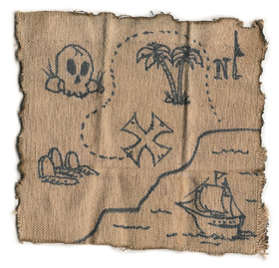
Movement
Reactive
Planned

Slide 7



Reactive Movement

Slide 8
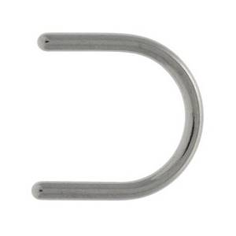
Planned Movement

Slide 9
Planned Movement

Slide 10
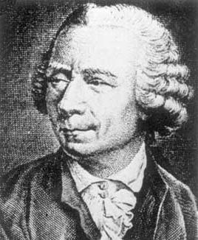
Steering: Physics Model
Simple Vehicle Model
orientation, mass, position, velocity
max_force, max_speed
Forward Euler Integration
steering_force = truncate (steering_dir, max_force)
acceleration = steering_force / mass
velocity = truncate (velocity + acceleration, max_speed)
position = position + velocity

Slide 11
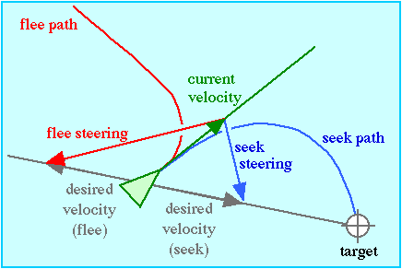
Seek and Flee

Slide 12
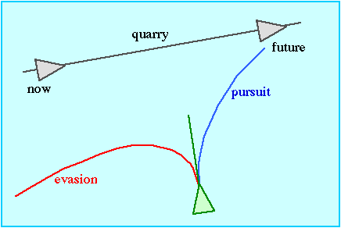
Pursue and Evade

Slide 13
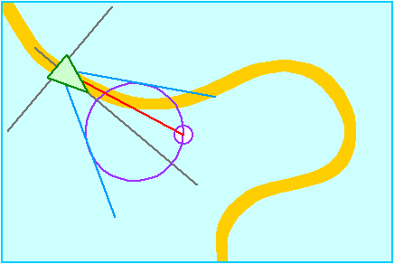
Wander

Slide 14
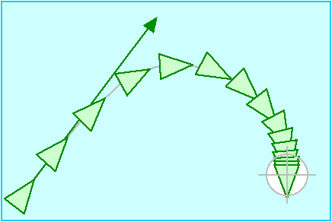
Arrival

Slide 15
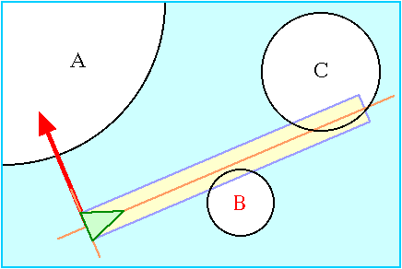
Obstacle Avoidance

Slide 16
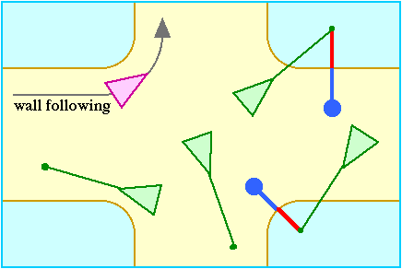
Wall Following & Containment

Slide 17
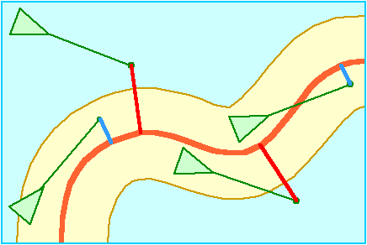
Path Following

Slide 18
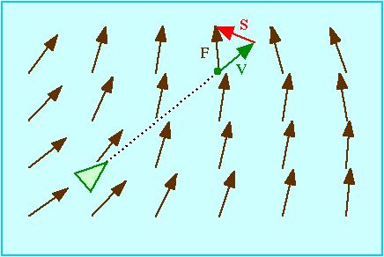
Flow Field

Slide 19
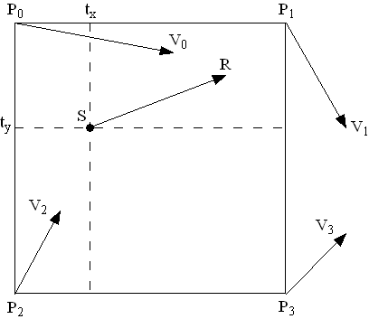
Flow Field: Bilinear Interpolation

Slide 20

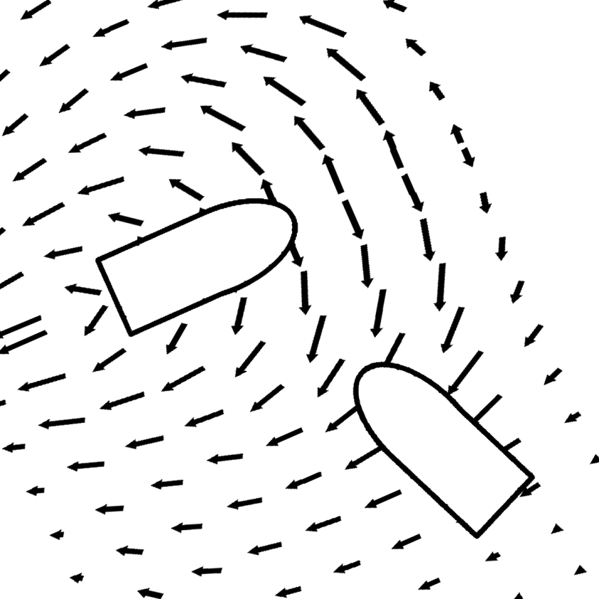
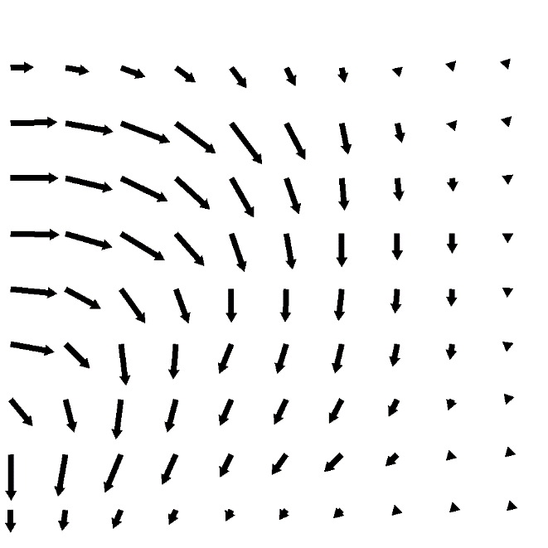
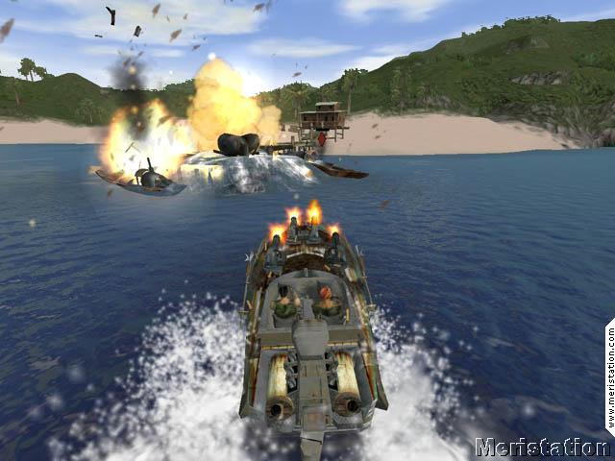
Avoidance using Flow Fields

Slide 21
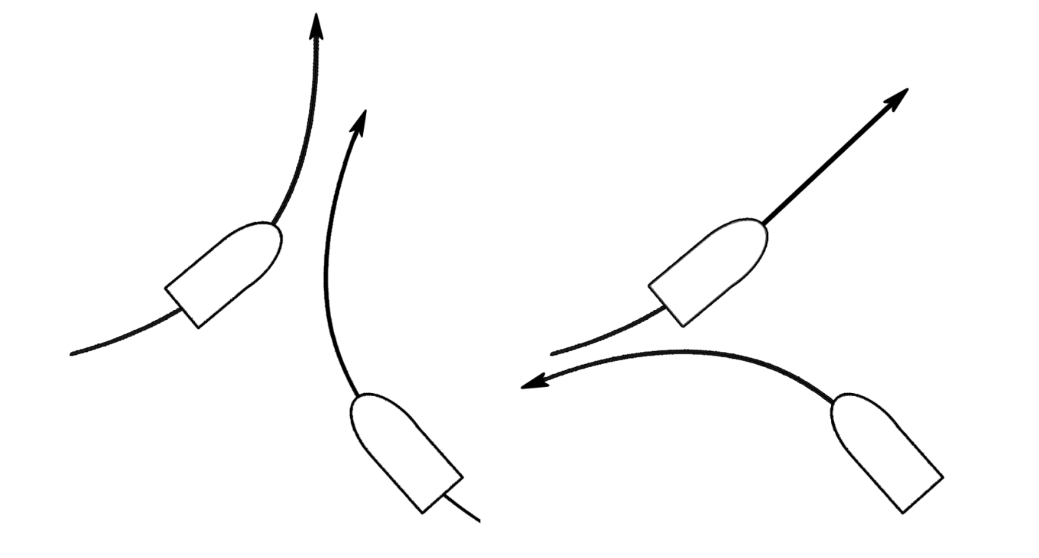
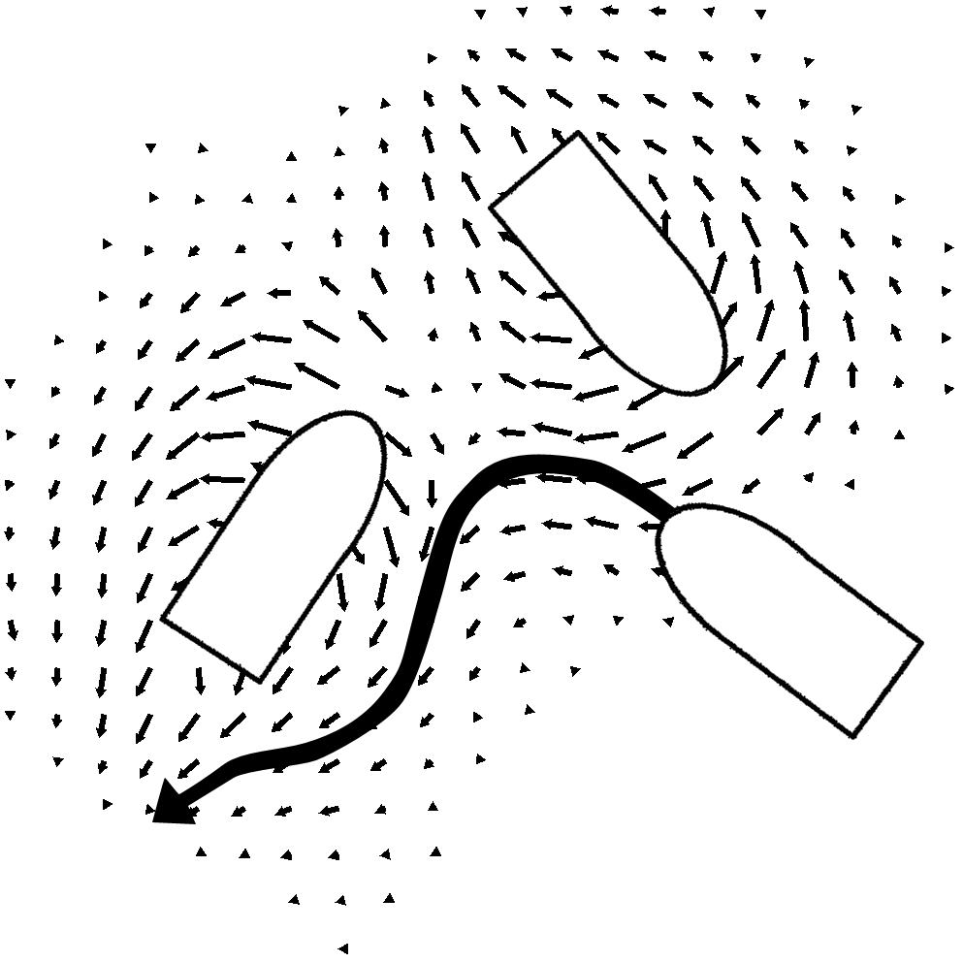
Avoidance using Flow Fields

Slide 22
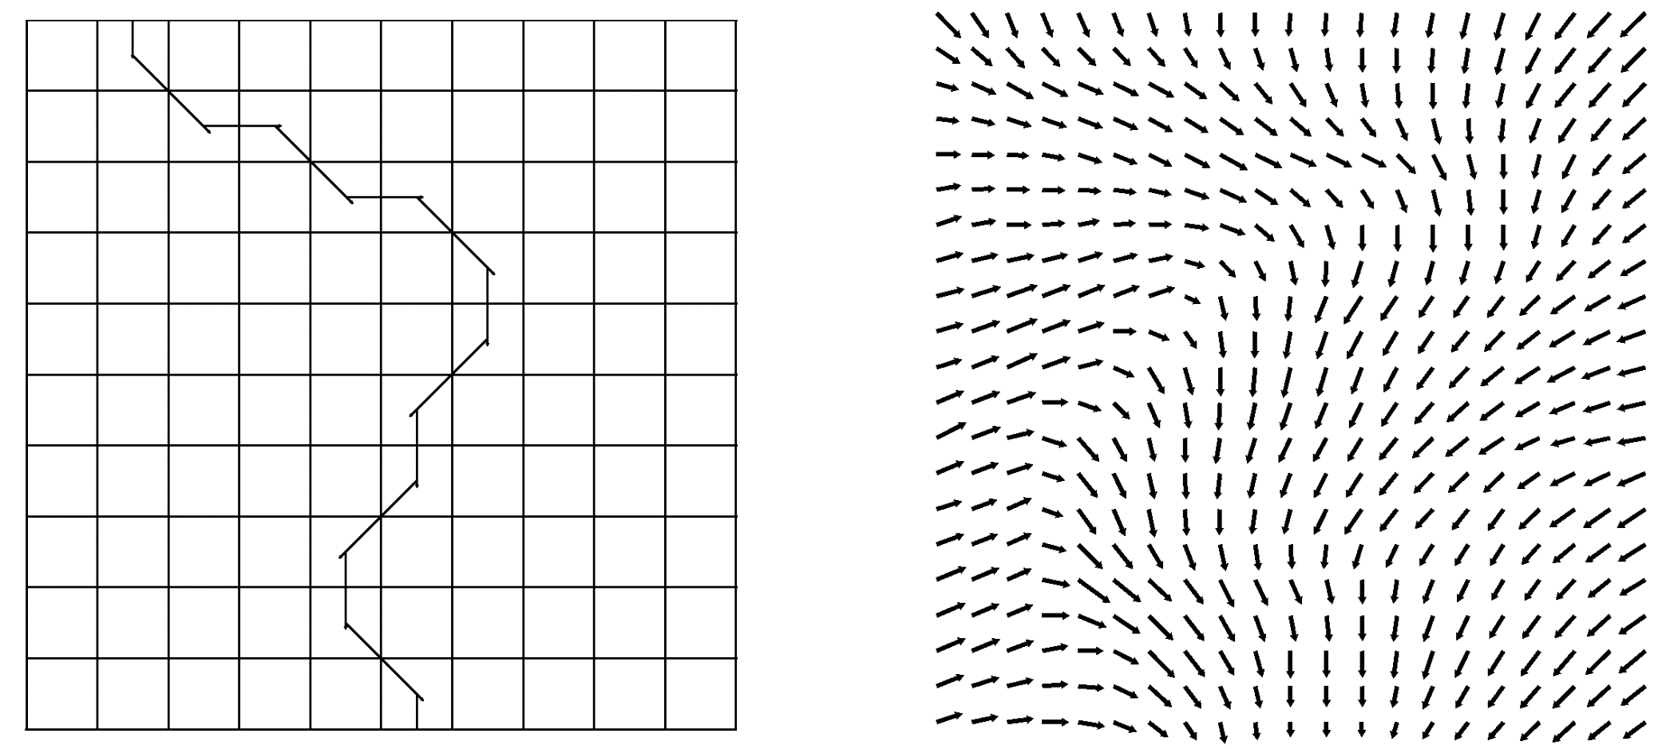
Smoothing using Flow Fields

Slide 23
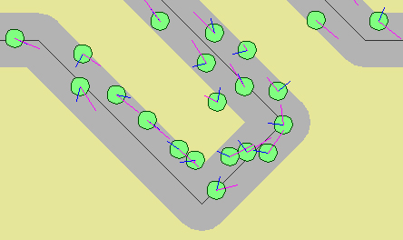
Group Path Following
(3x Path Following steering force) + (1x Separation steering force)

Slide 24
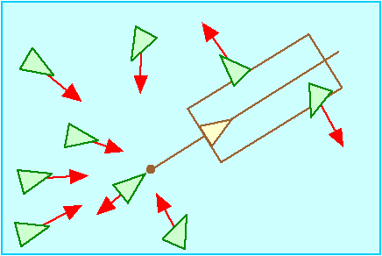
Leader Following

Slide 25
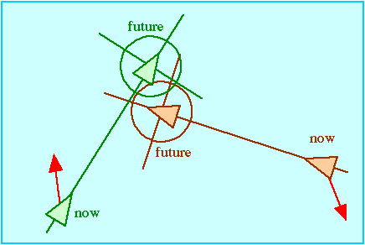
Unaligned Collision Avoidance

Slide 26
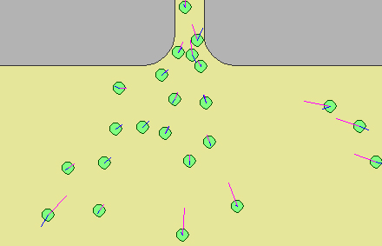
Queuing
Seek doorway + Containment + Separation

Slide 27
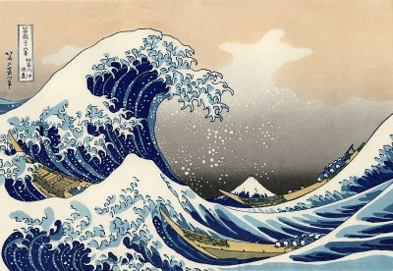
The Wave

Slide 28
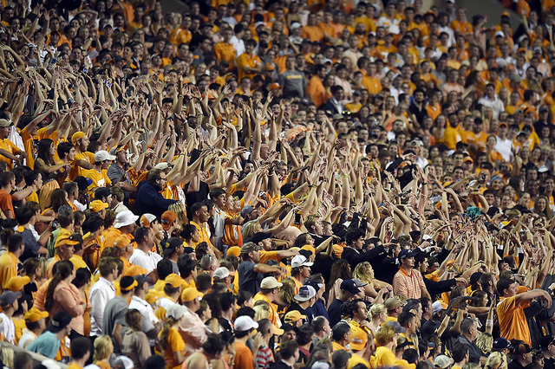
The Wave

Slide 29
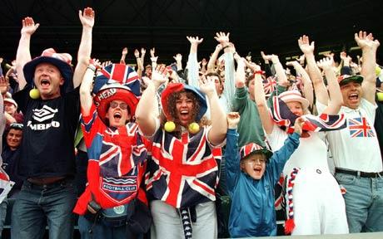
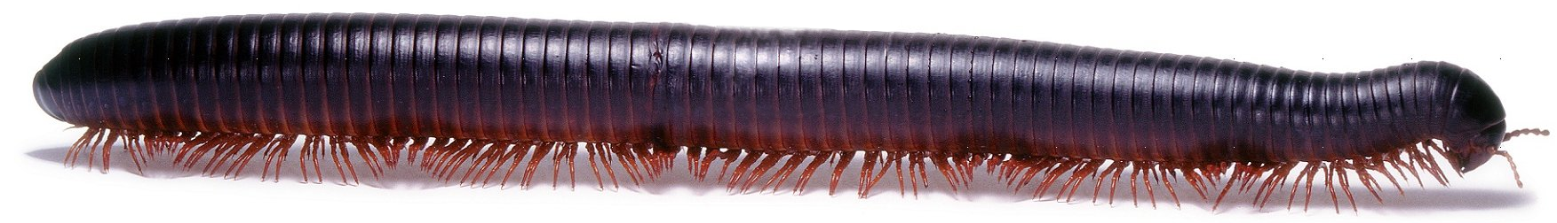
The Wave
Invented in the late 1970s
Achieved in a packed stadium when successive groups of spectators briefly stand, yell, and raise their arms. Immediately upon stretching to full height, the spectator returns to the usual seated position.
Example of a Metachronal rhythm
Like the legs on a millipede

Slide 30
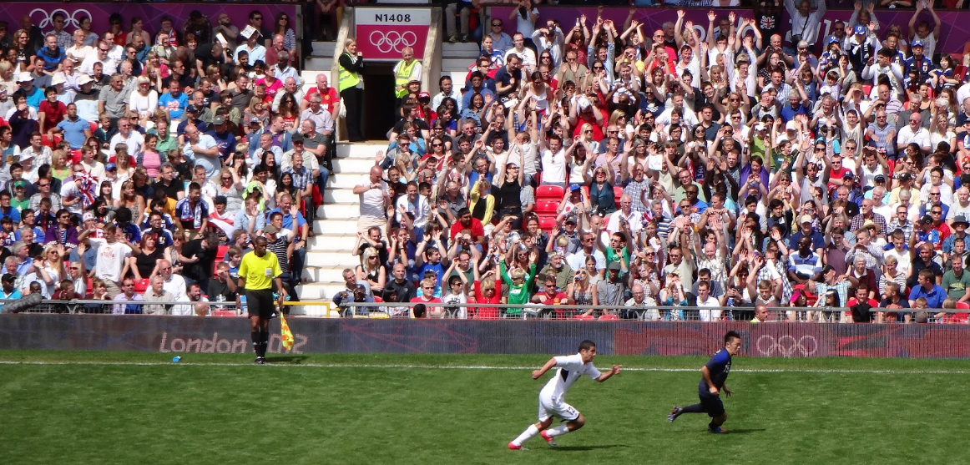
The Wave
Analysis by Tamás Vicsek (Nature 2002)
Usually rolls in a clockwise direction
Travels at 40ft/s or 22 seats per second
The wave is about 15 seats wide

Slide 31
The Wave

Slide 32

The Ripple

Slide 33

The Ripple with Reflection

Slide 34
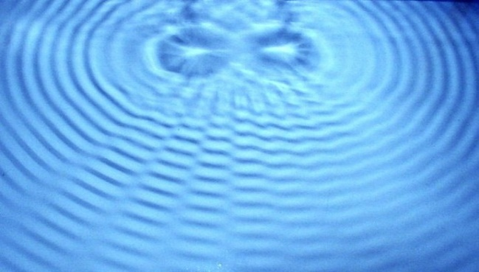

Wave Interference

Slide 35
Videos to queue up
Conway’s Game of Life
https://www.youtube.com/watch?v=C2vgICfQawE
Lion King Wildebeest Stampede
https://www.youtube.com/watch?v=FbLA0LS67XE
Stanley and Stella in Breaking the Ice
https://www.youtube.com/watch?v=3bTqWsVqyzE
Starling Swarm
https://www.youtube.com/watch?v=DmO4Ellgmd0

Slide 36


Cellular Automata Conways Game of Life (1970)
IF ALIVE
Less than 2 live neighbors, then DIE
(as if caused by under-population)
2 or 3 live neighbors, then LIVE
4 or more live neighbors, then DIE
(as if by overcrowding)
IF DEAD
Exactly 3 live neighbors, then LIVE
(as if by reproduction)

Slide 37
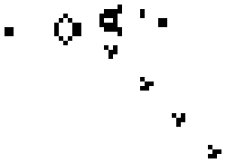
Gosper’s Glider Gun

Slide 38

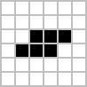


Oscillators
Pulsar
Blinker
Toad
Pentadecathlon
Beacon

Slide 39

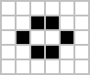



Still Life
Block
Beehive
Loaf
Boat
Tub

Slide 40
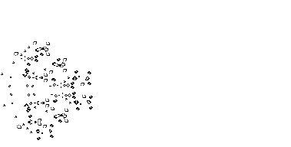
MSM Breeder
A puffer
that produces
Gosper guns,
which in turn emit
gliders

Slide 41

Spaceships

Slide 42

Puffer Train

Slide 43
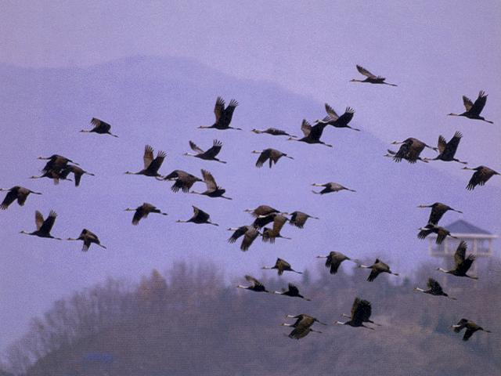
Flocking

Slide 44
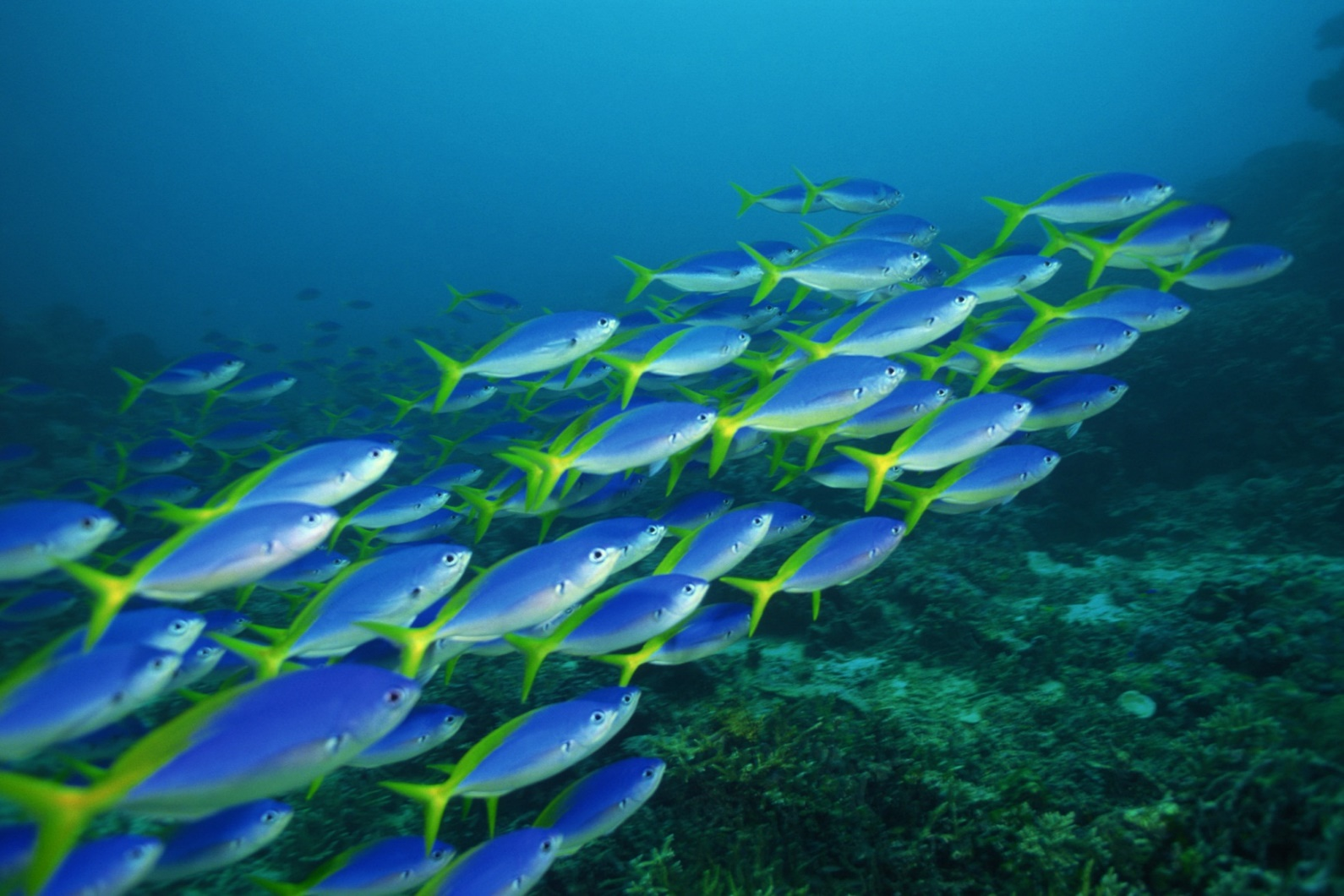
Flocking

Slide 45
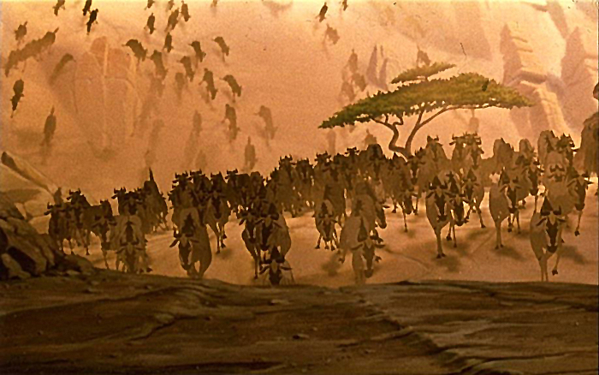
Flocking

Slide 46
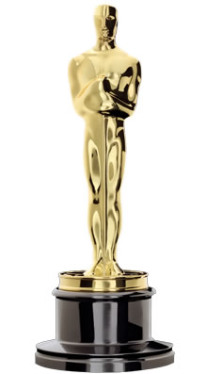
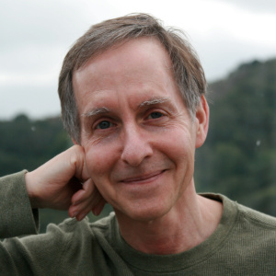
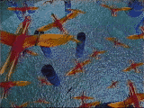
Flocking
First demonstrated by Craig Reynolds in his 1987 SIGGRAPH paper and movie
“Flocks, Herds, and Schools: A Distributed Behavior Model”
Film: “Stanley and Stella in Breaking the Ice"
1997
Scientific and Technical Award

Slide 47
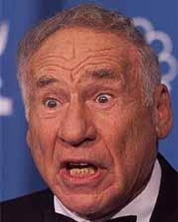
Boids
“The name had three influences. One was based on a Brooklyn accent, particularly this scene from Mel Brooks' original 1968 film The Producers:”
“You used to be able to sit on the stoop like a normal person, but not any more, ‘cause of da BOIDS. Dirty, lousy, stinkin’ BOIDS.”

Slide 48
Boids
“Another was a very early (~1978?) 3D modeling/rendering system built by Tom Duff (then of the pioneering Graphics Lab of New York Institute of Technology, now at Pixar). The basic modeling primitive of Tom’s system were arbitrary ellipsoids in 3D. He called the system “soids” which I thought was a cool sounding name.”

Slide 49
Boids
“The least fanciful aspect of the name was that the individuals in my flocks were meant to simulate a small part of a real bird’s behavioral repertoire, so they were “bird-like autonomous agents”. I briefly considered calling them bird-oid, but for the two reasons above I quickly slipped into calling them “boids”.”
– Craig Reynolds (personal email May 24, 2013)

Slide 50
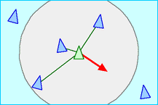
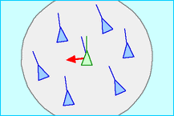
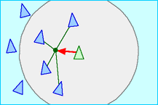
Flocking: 3 Simple Rules
Separation
Alignment
Cohesion

Slide 51
Flocking: 3 Other Rules
Obstacle avoidance
Wandering
Tether
Also, each boid should have random properties (within a small range)
Speed
Acceleration

Slide 52
Tether
If within bounds, Tether has no steering effect.
Global goal is at the center of bounds
Fancier implementation: Periodically move the global goal to a random place within the bounds for variety.
If a Boid goes beyond the Tether bounds, have it (ever-so-slightly) steer toward the Global goal until it is within bounds.

Slide 53
Separation
Alignment
Cohesion
Obstacle Avoidance
Wander
Tether

Slide 54
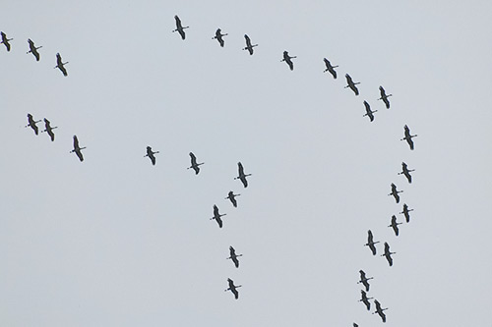
How do you get this?

Slide 55
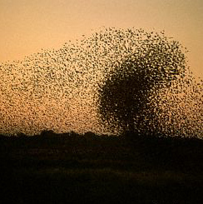
Swarms
Just Cohesion?
Some Alignment?
Any Separation?

Slide 56
Swarm Intelligence
Technique based on collective behavior in decentralized, self-organized systems
Beni & Wang (1989)
Simple agents interact locally
Global behavior emerges
Ant colonies, bird flocking, animal herding
Swarm Robotics
Combining swarm intelligence with robotics

Slide 57
Swarm Intelligence
U.S. military
Swarm techniques for controlling unmanned vehicles
Strategic Defense Initiative (tiny pebbles = satellite-based lasers)
NASA
Swarm technology for planetary mapping
Medical
Kill cancer tumors with swarming nanobots (1992 paper by M. Anthony Lewis and George A. Bekey)
Movies
Flocking in Disney's The Lion King was the first movie to make use of swarm technology (the stampede scene).
Lord of the Rings used emergent behavior during the battle scenes.
Benefits of swarm technology
Cheap, robust, and simple

Slide 58
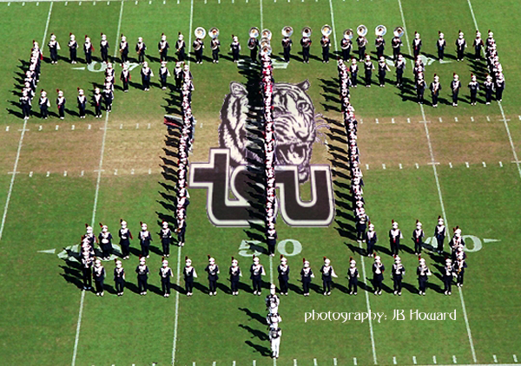
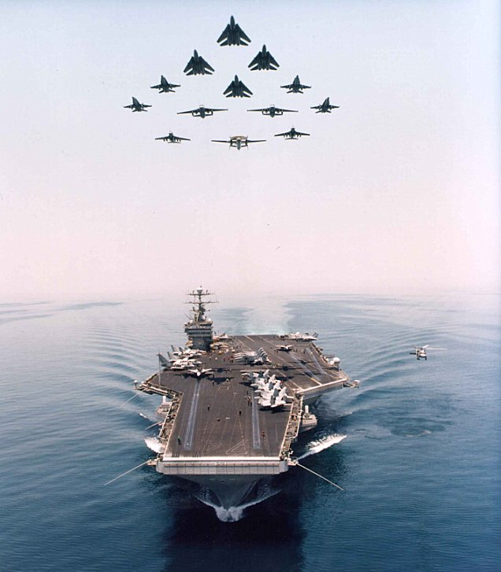
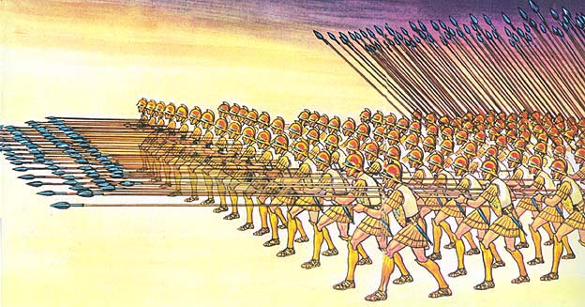
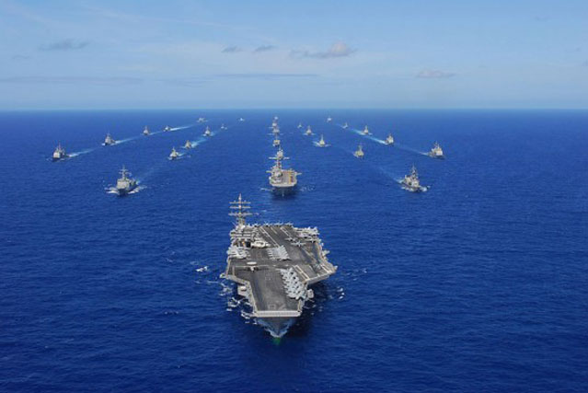
Formations
Mimics military formations
How is it similar to flocking?
How is it different from flocking?

Slide 59
Leader steers
Individuals steer (Arrival to relative offsets)

Slide 60
Lag effect

Slide 61
Lag effect

Slide 62
Lag effect

Slide 63
Lag effect

Slide 64
Lag effect

Slide 65
Template steers
Individuals steer (Arrival to assigned spots)
(no lag effect)
Template
Template

Slide 66
Template

Slide 67
Template

Slide 82
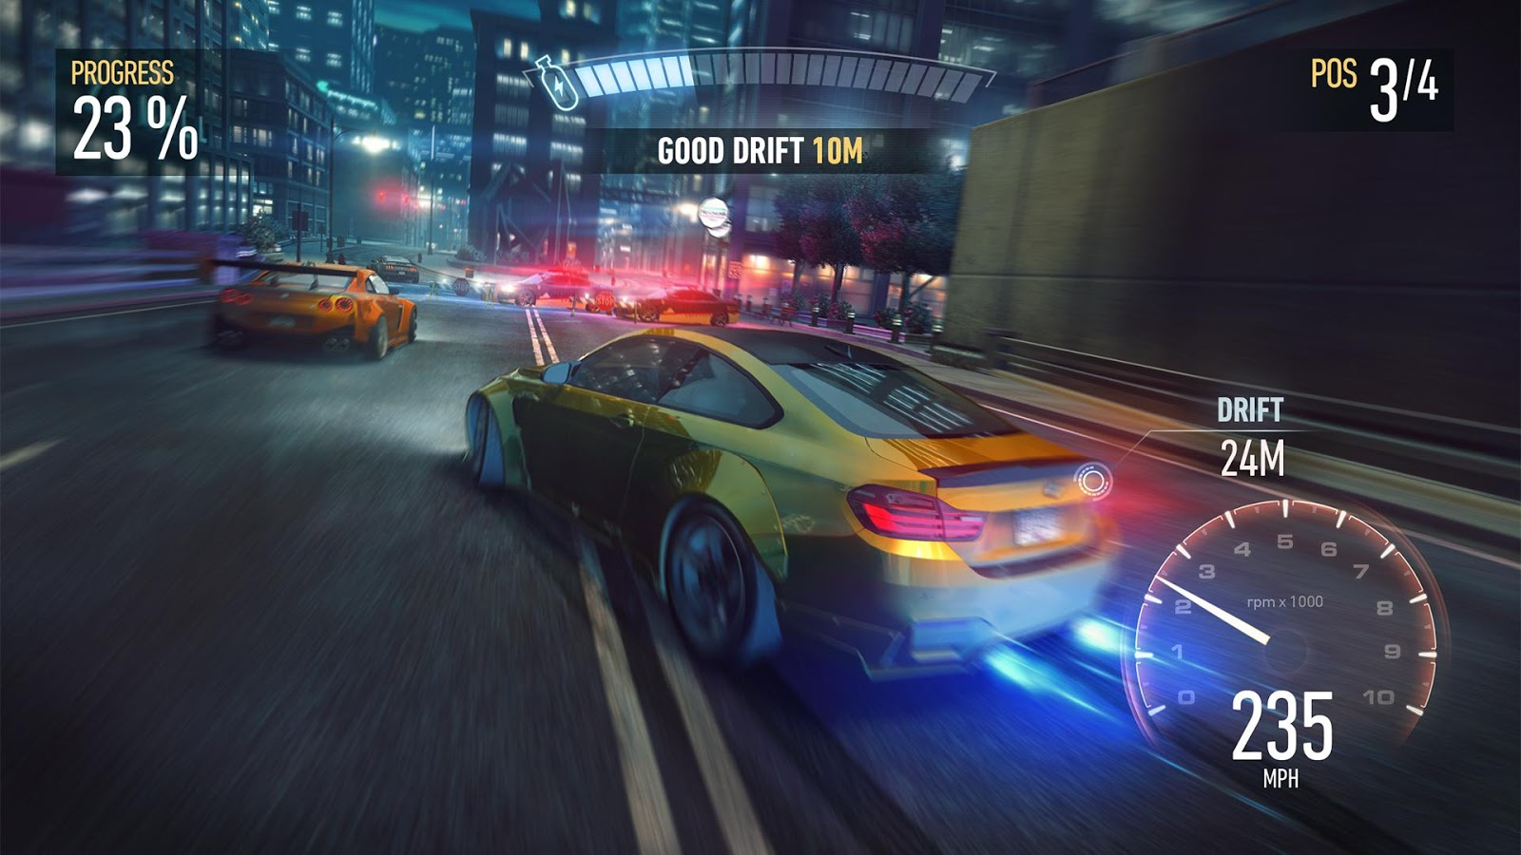
PID Controller for Steering
Proportional-Integral-Derivative
Feedback-based algorithm
50 year old technique
Used in most car racing games to steer cars

Slide 83
PID Controller for Steering
1st term is proportional to the current error
2nd term is proportional to the integral of the error
3rd term is proportional to the derivative of the error

Slide 84
PID Controller for Steering
1st is value of current error
2nd is last several values of the error, multiplied by their time-steps, and all added up
3rd is approximated by taking the current error, subtracting previous error, and dividing by time-step

Slide 85
Questions
Name as many steering behaviors as you can.
Which steering behavior converts uniform randomness into smooth randomness?
What were the steering behavior rules for the follow the leader example? (ducklings version)
Flow fields work best in what kind of environments?
Name as many ways as you can think of to generate the vectors in a flow field.
What does group emergent behavior emerge from?

